Slide 1
Unit 1: Introduction to Java

Slide 2
What is Java?
Why Use Java?
Java is a popular programming language, created in 1995. It is owned by Oracle, and more than 3 billion devices run Java. It is used for:
Mobile applications (specially Android apps)
Desktop applications
Web applications
Web servers and application servers
Games
Database connection
And much, much more!
Java works on different platforms (Windows, Mac, Linux, Raspberry Pi, etc.)
It is one of the most popular programming language in the world
It is easy to learn and simple to use
It is open-source and free
It is secure, fast and powerful
It has a huge community support (tens of millions of developers)

Slide 3

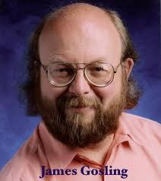
History of Java
James Gosling, Mike Sheridan, and Patrick Naughton initiated the Java language project in June 1991. The small team of sun engineers called Green Team.
Originally designed for small, embedded systems in electronic appliances like set-top boxes.
Firstly, it was called "Greentalk" by James Gosling, and file extension was .gt.
After that, it was called Oak and was developed as a part of the Green project.
Why Oak? Oak is a symbol of strength and chosen as a national tree of many countries like U.S.A., France, Germany, Romania, etc.
In 1995, Oak was renamed as "Java" because it was already a trademark by Oak Technologies.
Initially developed by James Gosling at Sun Microsystems (which is now a subsidiary of Oracle Corporation) and released in 1995.
In 1995, Time magazine called Java one of the Ten Best Products of 1995.
JDK 1.0 released in(January 23, 1996).

Slide 4
Characteristics of Java
Simple
syntax similar to C/C++
Confusing features such as pointers, operator overloading are removed from java
Object Oriented
Everything in java is an object
Java Supports OOP Features such as Inheritance, Polymorphism, Encapsulation, Abstraction etc.
Distributed
Remote Method Invocation (RMI) and Enterprise Java Beans (EJB) are used for creating distributed applications.
We may access files by calling the methods from any machine on the internet.
Robust
Robust means Strong. Java uses strong memory management.
Features such as Garbage collection, exception handling, type checking etc. makes java strong.
Secure
Security is the major concern since java is meant to be used in networked environments.
Access levels such as private, protected, public & default.
Architectural Neutral
Byte codes are Platform Independent because it can run on multiple platforms.

Slide 5
Portable
Write once, run anywhere is the concept of portability.
We can carry java byte code to any platform and execute there.
Compiled and Interpreted
Usually a computer language is either compiled or interpreted. Java combines both and so its called two-stage system.
Java compiler translates source code into byte code
Java Interpreter translates byte code to machine code
High Performance
Java is faster than traditional languages.
The performance is due to JIT (just in Time) compilation that cache the recurring process to speed up the process.
10. Multithreaded
The main advantage is that it shares the same memory.
Threads are important for multi-media, web applications etc.

Slide 6
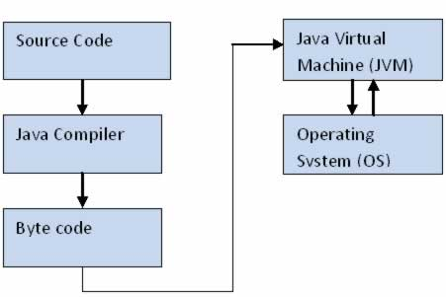
Java Virtual Machine (JVM)
The JVM manages system memory and provides a portable execution environment for Java-based applications
The JVM has two primary functions: to allow Java programs to run on any device or operating system (known as the "Write once, run anywhere" principle), and to manage and optimize program memory.
It converts Java byte code into machines language. JVM is a part of JRE(Java Run Environment).
The JVM manages memory through a process called garbage collection, which continuously identifies and eliminates unused memory in Java programs. Garbage collection happens inside a running JVM.

Slide 7
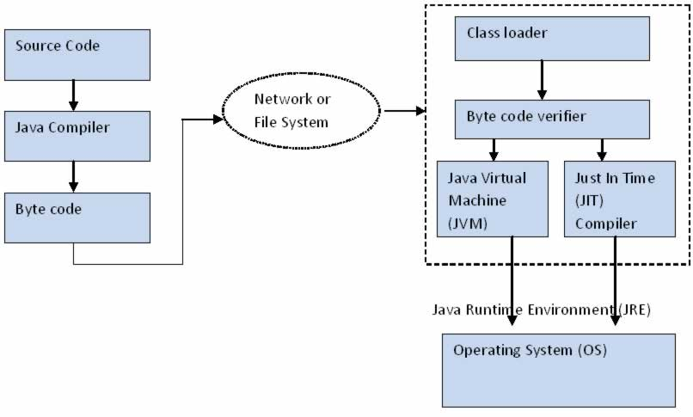
Java Architecture / Working of JVM / How Java Works?

Slide 8
Java source code (.java files) is compiled into byte code by java compiler.
Byte code is not executable code for the target machine; rather it’s a object code for JVM. Byte code will be stored in class files (.class).
During run time, this byte code will be loaded, verified and JVM interprets the byte code into machine code which will be executed in the machine in which the java program runs.
Class loader loads all the class files required to execute the program. Class loader makes the program secure by separating the namespace for the classes obtained through the network from the classes available locally.
Next step is Byte code verification by byte code verifier. It checks the byte code and ensure the following:
The Code follows JVM Specifications
There is no unauthorized access to memory
The code doesn’t cause any stack overflows
There is no illegal data conversions in the code such as float to object references.
Once the code is verified, and proven that there is no security issue with code, JVM will convert the byte code into machine code .
Just in Time (JIT) Compiler is a component that helps the program execution to happen faster. Code is cached by JIT Compiler and will be reused for the future needs.

Slide 9
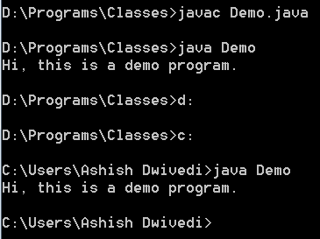
Path and Classpath Variables in Java
path is a mediator between developer and operating system to inform binary file path where as Classpath is a mediator between developer and compiler to inform the library file path those are used in our source code
The path points to the location of the jre i.e. the java binary files such as the jvm and necessary libraries. The classpath points to the classes you developed so that the jvm can find them and load them when you run your product.
So essentially you need the path to find java so it can then find your classes and run them from the classpath
We don't need to set PATH and CLASSPATH to compile and run java program while using IDE like Eclipse. These environment variables are required to compile and run java program using CMD.

Slide 10
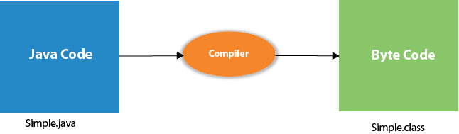
First Java Program | Hello World Example
class Simple{
public static void main(String args[]){
System.out.println("Hello Java");
}
}
save this file as Simple.java
To compile: javac Simple.java
To execute: java Simple
Output:Hello Java

Slide 11
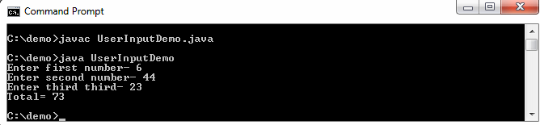
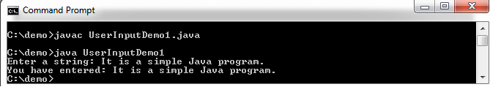
How to get input from user in Java
import java.util.*;
class UserInputDemo
{
public static void main(String[] args)
{
Scanner sc= new Scanner(System.in); //System.in is a standard input stream
System.out.print("Enter first number- ");
int a= sc.nextInt();
System.out.print("Enter second number- ");
int b= sc.nextInt();
System.out.print("Enter third number- ");
int c= sc.nextInt();
int d=a+b+c;
System.out.println("Total= " +d);
}
}
import java.util.*;
class UserInputDemo1
{
public static void main(String[] args)
{
Scanner sc= new Scanner(System.in); //System.in is a standard input stream
System.out.print("Enter a string: ");
String str= sc.nextLine(); //reads string
System.out.print("You have entered: "+str);
}
}

Slide 12
Classwork
Write a program in Java to find factorial of n number, entered by user.
Reverse a number
Print duplicate elements in an Array
Copy elements of one array into next array
Count total number of characters from a string

Slide 13
Java Arrays
Arrays are used to store multiple values in a single variable, instead of declaring separate variables for each value.
To declare an array, define the variable type with square brackets:
String[] cars;
We have now declared a variable that holds an array of strings. To insert values to it, we can use an array literal - place the values in a comma-separated list, inside curly braces:
String[] cars = {"Volvo", "BMW", "Ford", "Mazda"};
public class MyClass { public static void main(String[] args) { int[][] myNumbers = { {1, 2, 3, 4}, {5, 6, 7} }; for (int i = 0; i < myNumbers.length; ++i) { for(int j = 0; j < myNumbers[i].length; ++j) { System.out.println(myNumbers[i][j]); } } } }
String[] cars = {"Volvo", "BMW", "Ford", "Mazda"}; for (String i : cars) { System.out.println(i); }

Slide 14
1.2 Class and Object
Java is an object-oriented programming language.
Everything in Java is associated with classes and objects, along with its attributes and methods. E.g.: in real life, a car is an object. The car has attributes, such as weight and color, and methods, such as drive and brake.
A Class is like an object constructor, or a "blueprint" for creating objects.
Create a Class:
Create an Object:
In Java, an object is created from a class. We have already created the class named MyClass, so now we can use this to create objects.
To create an object of MyClass, specify the class name, followed by the object name, and use the keyword new:
Create an object called "myObj" and print the value of x:
public class MyClass {
int x = 5;
public static void main(String[] args) {
MyClass myObj = new MyClass();
System.out.println(myObj.x);
}
}
Create a class called "MyClass" with a variable x:
public class MyClass {
int x = 5;
}

Slide 15

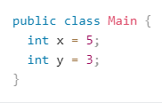


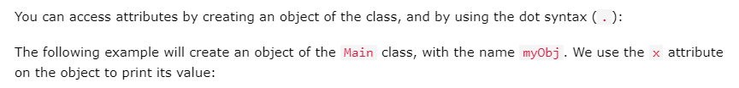
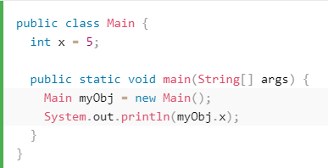

Slide 16



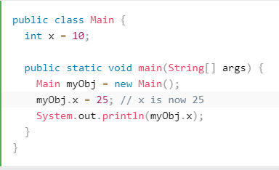

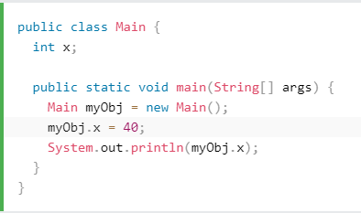
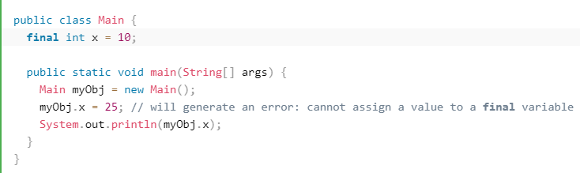


Slide 17

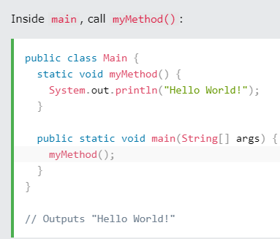
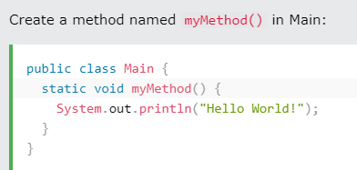

To call a method, write the method's name followed by two parentheses () and a semicolon;

Slide 18
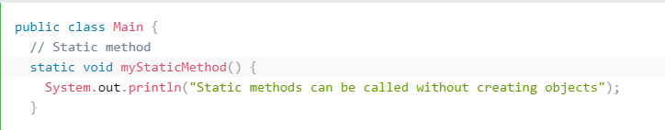
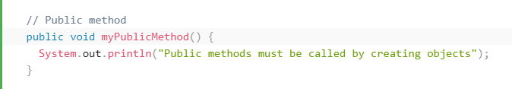
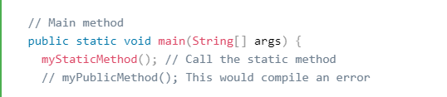
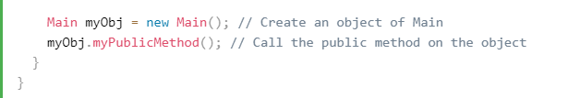

Slide 19
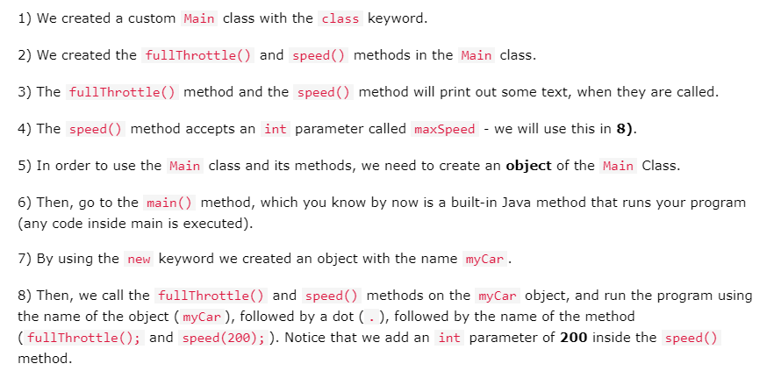

Slide 20
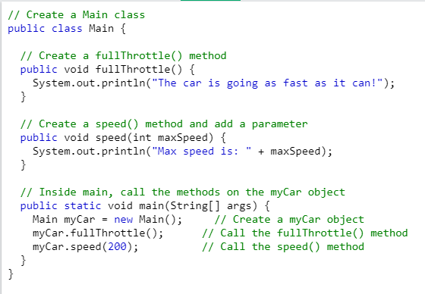


Slide 21

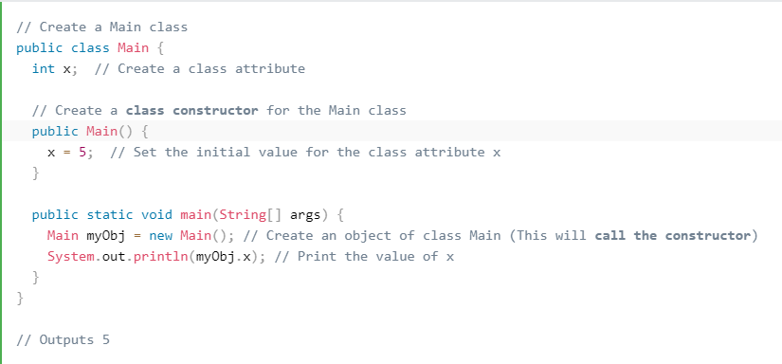

Slide 22
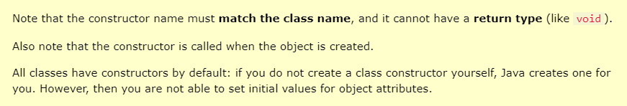

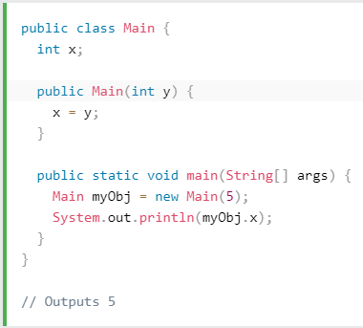
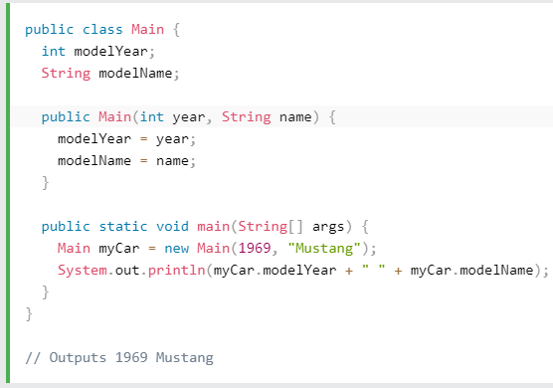

Slide 23
Modifiers in Java
We divide modifiers into two groups:
Access Modifiers - controls the access level
Non-Access Modifiers - do not control access level, but provides other functionality
Access Modifiers
For classes, you can use either public or default:
For attributes, methods and constructors, you can use the one of the following:
Modifier | Description
public | The code is accessible for all classes
private | The code is only accessible within the declared class
default | The code is only accessible in the same package. This is used when you don't specify a modifier.
protected | The code is accessible in the same package and subclasses.
Modifier | Description
public | The class is accessible by any other class
default | The class is only accessible by classes in the same package. This is used when you don't specify a modifier.

Slide 24
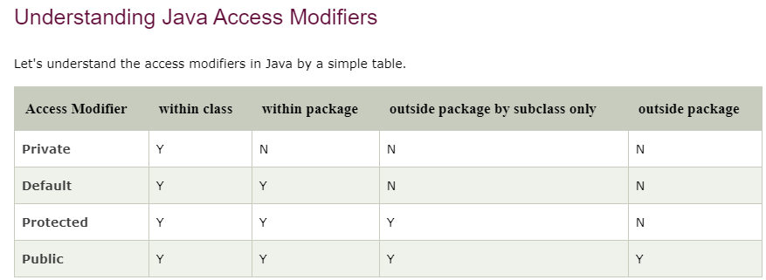

Slide 25
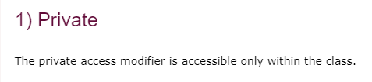
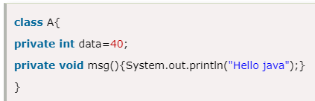
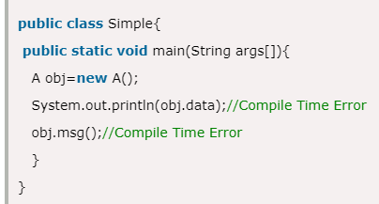

Slide 26
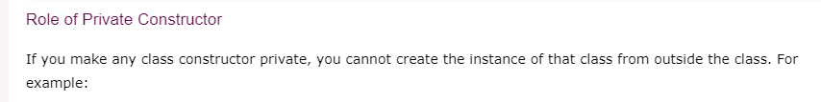
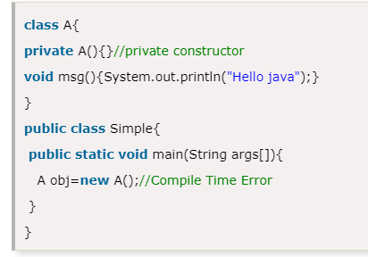

Slide 27
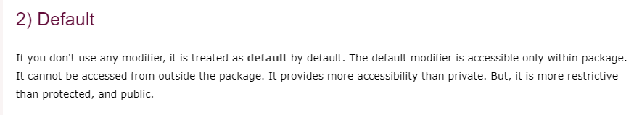
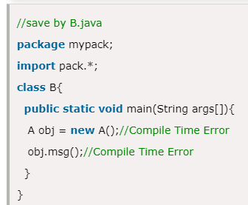
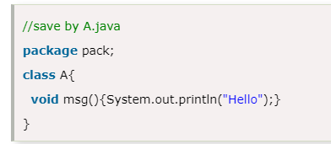

Slide 28
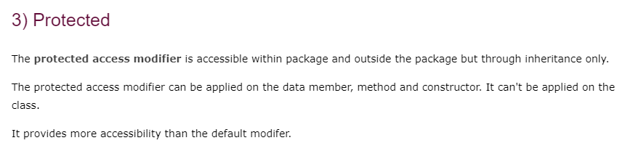
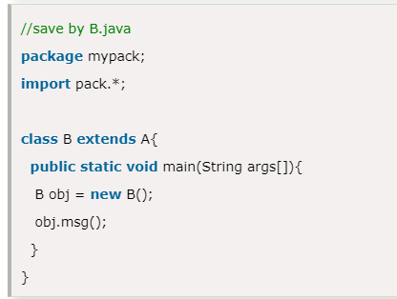
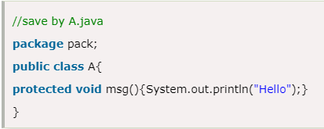


Slide 29
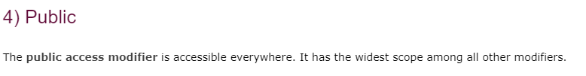
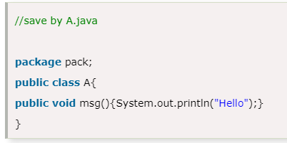
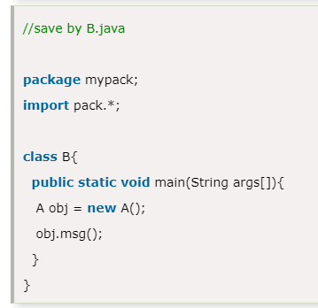


Slide 30
Java Packages
A package in Java is used to group related classes. Think of it as a folder in a file directory. We use packages to avoid name conflicts, and to write a better maintainable code. Packages are divided into two categories:
Built-in Packages (packages from the Java API)
User-defined Packages (create your own packages)
Built-in Packages
The library is divided into packages and classes. Meaning you can either import a single class (along with its methods and attributes), or a whole package that contain all the classes that belong to the specified package.
To use a class or a package from the library, you need to use the import keyword:
import package.name.Class; // Import a single class import package.name.*; // Import the whole package
import java.util.Scanner;
import java.util.*;

Slide 31
User-defined Packages
To create your own package, you need to understand that Java use a file system directory to store them. Just like folders on your computer:
Example
└── root
└── mypack
└── MyPackageClass.java
To create a package, use the package keyword:
package mypack;
class MyPackageClass {
public static void main(String[] args) {
System.out.println("This is my package!");
}
}
Save the file as MyPackageClass.java, and compile it:
C:\Users\Your Name>javac MyPackageClass.java
Then compile the package:
The -d keyword specifies the destination for where to save the class file.
C:\Users\Your Name>javac -d . MyPackageClass.java
To run the MyPackageClass.java file, write the following:
C:\Users\Your Name>java mypack.MyPackageClass
The output will be:
This is my package!

Slide 32
Java Inheritance (Subclass and Superclass)
class Vehicle { protected String brand = "Ford"; // Vehicle attribute public void honk() { // Vehicle method System.out.println("Tuut, tuut!"); } } class Car extends Vehicle { private String modelName = "Mustang"; // Car attribute public static void main(String[] args) { // Create a myCar object Car myCar = new Car(); // Call the honk() method (from the Vehicle class) on the myCar object myCar.honk(); // Display the value of the brand attribute (from the Vehicle class) and the value of the modelName from the Car class System.out.println(myCar.brand + " " + myCar.modelName); } }
In Java, it is possible to inherit attributes and methods from one class to another. We group the "inheritance concept" into two categories:
subclass (child) - the class that inherits from another class
superclass (parent) - the class being inherited from
To inherit from a class, use the extends keyword.
In the example below, the Car class (subclass) inherits the attributes and methods from the Vehicle class (superclass)
Why And When To Use "Inheritance"?
- It is useful for code reusability: reuse attributes and methods of an existing class when you create a new class.

Slide 33
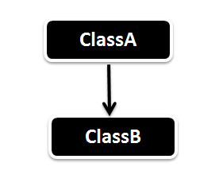
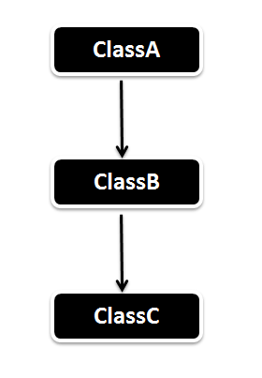
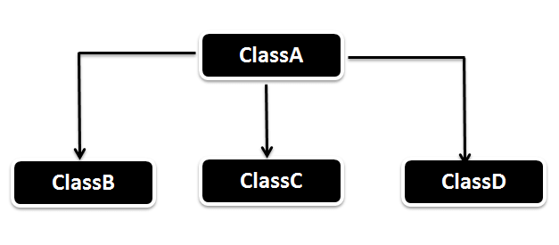
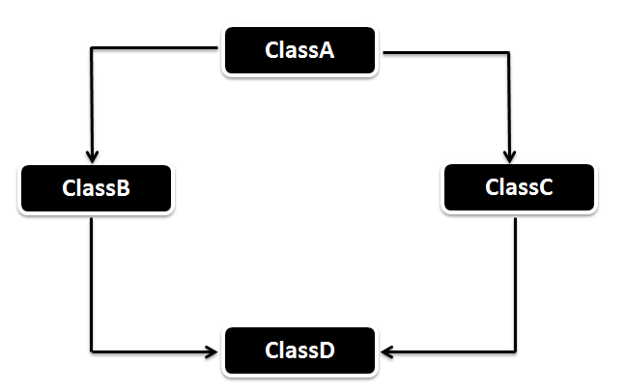
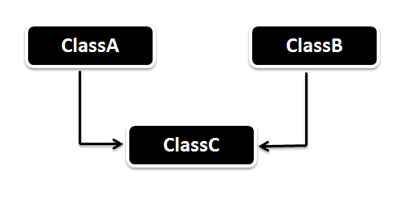
Types of Inheritance in Java
1. Single Inheritance
2. Multilevel Inheritance
3. Hierarchical Inheritance
4. Multiple Inheritance (Through Interface)
5. Hybrid Inheritance (Through Interface)

Slide 34
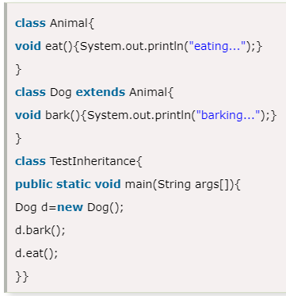

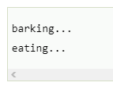

Slide 35
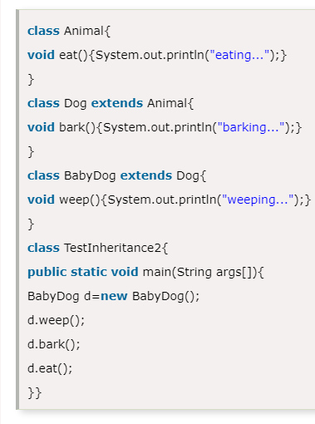

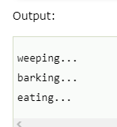

Slide 36
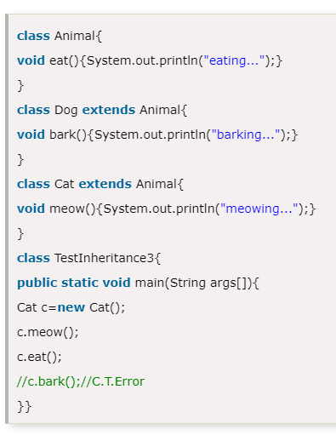



Slide 37





Slide 38





Slide 39



Slide 40




Slide 41





Slide 42



An interface is declared by using the interface keyword.
It provides total abstraction; means all the methods in an interface are declared with the empty body, and all the fields are public, static and final by default.
A class that implements an interface must implement all the methods declared in the interface.

Slide 43





Slide 44



Slide 45




Slide 46


Will this compile?

